Slide 1
EE386 Lab 7:
Imaging Zooming by Interpolation
Presented by
Paco Ellaga

Slide 2
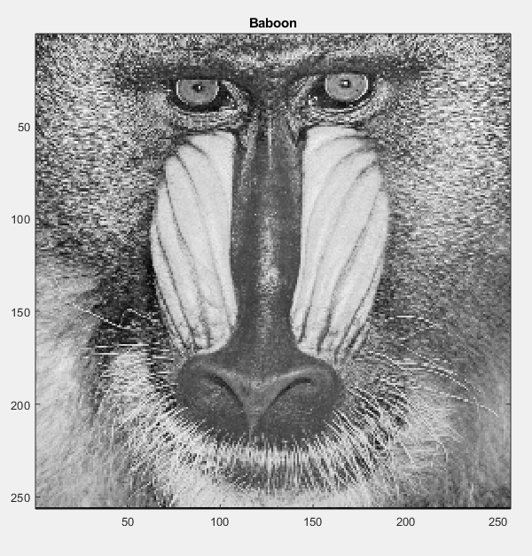

Original Picture:
Baboon
A double class image of 256x256 bytes
Found from spfirst.gatech.edu toolbox
Listed as .mat file needed show_img()
imshow() gives black screen
Notes:
Typed in whos command for detail
Image was already grayed, so no need to change
Command:
mat2gray()

Slide 3
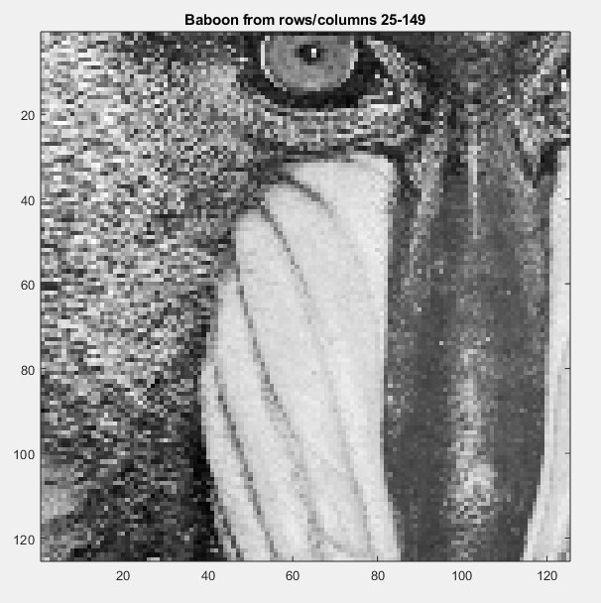
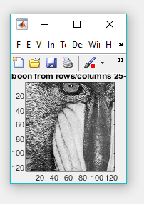
Zoomed in Version
Rows & columns 25 -> 149
Relative to actual unit size
Resolution size of the window changes scaling
Notes:
Commands:
x = xx(25:149, 25:149); % reforms image from row/column 25-149
ZoomedBaboon = show_img(x

Slide 4
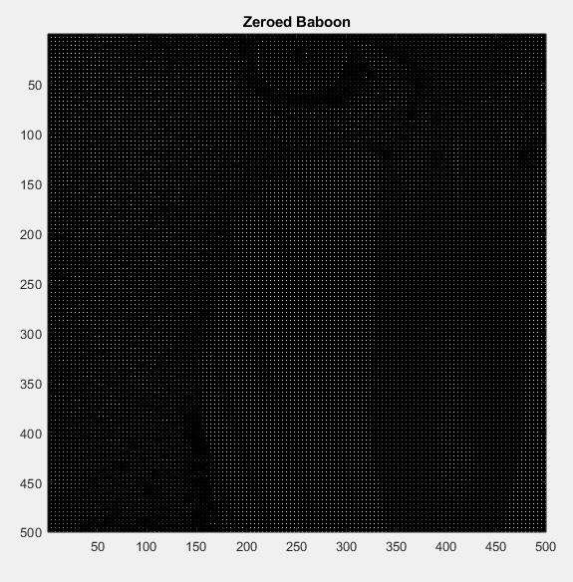
Zero based Interpolation
Image was small so had to rescale to length
4 for every direction
Sample : Period : M (or N) direction
Allows for respacing and increasing size
Overall matches size but has many holes
Notes:
Commands: Length = length(x); % for the length of reform
yy = zeros(1,4*Length); % marking zeroes
yy(4:4:4*Length, 4:4:4*Length) = x; % formatting the zeroes

Slide 5
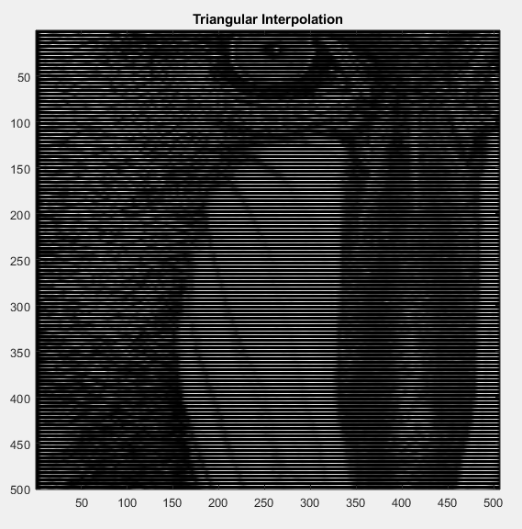
Triangular Interpolation
Cuts the picture in pieces and aligns them together
More coefficients = More smoothing More coefficients = Longer processing
Notes:
Commands:
coeff = [1/4, 2/4, 3/4, 1, 3/4, 1/2, 1/4];
tri = conv2(yy,coeff);

Slide 6
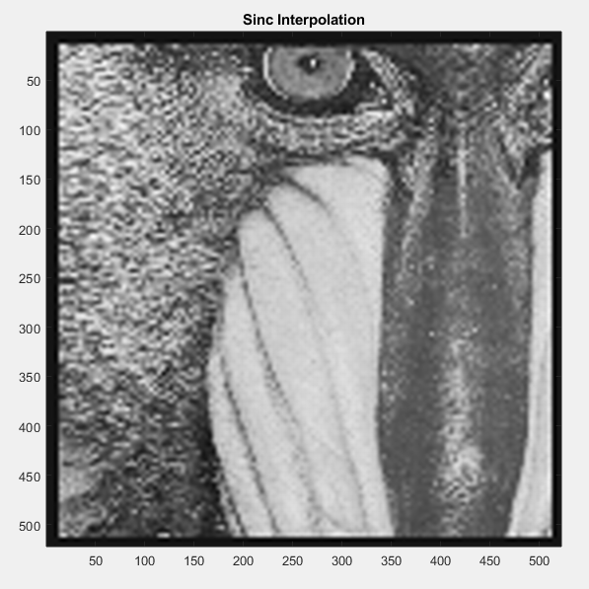
Sinc Interpolation
Sets clarity, but leaves blurring on edges.
Is based on filtering, will have limited passed due to the parameters of the image
Notes:
Command:
for i = 0:22
k = i + 1;
w(k) = 0.54 - 0.46*cos(2*pi*i/22);
if i == 11;
bb(k) = w(k);
else
bb(k) = sin(pi*(i-11)/4) / (pi*(i-11)/4) * w(k);
end;
end;
x_Filter = conv2(conv2(yy,bb),bb');

